Slide 1
IBM University Engagement Project Submission
“Exploring the Power of Agentic AI with IBM Granite and IBM Bob”

Slide 2

Project Tile – [Autonomous NIDS SOC Agent powered by IBM watsonx]
Domain of Project – [Cybersecurity / Network Security]
Student Name | Recent Passport Photo | Email ID | Mobile number [WhatsApp]
Ayush Kumar |  | Aspoke456@gmail.com | 9716644238
Recommended font style and size:
Font Style: Arial
Font Size (Heading): 28
Font Size (Content): 20

Slide 3
Problem statement No.40 – Network Intrusion Detection
The Challenge
Network administrators face massive volumes of traffic and struggle to identify intrusions (like DoS, Probes, or Privilege Escalation) in real-time. Manually analysing flow logs and writing secure firewall rules is time-consuming and prone to human error, leaving networks vulnerable.
The Objective
Build an AI-powered Network Intrusion Detection System (NIDS) SOC Agent that delivers autonomous threat classification and mitigation for security teams. The solution should:
Real-time Traffic Analysis: Classify network flow metrics (e.g., NSL-KDD features) into threat categories.
Threat Intelligence Retrieval: Map identified attacks to the MITRE ATT&CK framework.
Automated Mitigation: Generate precise iptables firewall scripts to block malicious IPs.
Safety Guardrails: Validate generated rules against enterprise safety policies before deployment.
Multi-Agent System:
  NIDS Classifier Agent (Retrieves ML predictions)
  Threat Intel Agent (Fetches MITRE context)
  Remediation Agent (Writes firewall scripts)
  Policy Guard Agent (Validates scripts for safety)

Slide 4
Proposed Solution -
The proposed solution is a multi-agent AI-powered SOC Assistant built using IBM Bob and IBM watsonx.ai to provide real-time, autonomous network defence.
At its core, it integrates a predictive Machine Learning model (Watson AutoAI trained on Kaggle NSL-KDD data) with an orchestration engine (LLaMA-3 via watsonx) to evaluate 41-feature network payloads.
The system consists of four key agents:
  NIDS Classifier Agent: Retrieves live predictions from the deployed Watson AutoAI model to categorize traffic (DoS, Probe, R2L, U2R, Normal).
  Threat Intel Agent: Queries MITRE ATT&CK knowledge bases to provide context and SOC prioritization.
  Remediation Agent: Generates custom Linux firewall mitigation scripts (iptables) targeted at the offending source IP.
  Policy Guard Agent: Validates the generated firewall rules against enterprise safety policies to prevent self-inflicted network outages.
The interactive Streamlit chat dashboard allows users to paste raw network alerts and receive instant, validated mitigation strategies.

Slide 5
Technology Used
IBM Bob platform -For designing and orchestrating multi-agent workflows visually
IBM Grainite model - for eg – ibm-granite-3-2-8b – For natural language understanding, reasoning, and personalization
IBM Cloud – It provides the infrastructure to build, deploy, and scale the Nutrition Agent efficiently. IBM Cloud enables a reliable, secure, and scalable environment for deploying the Nutrition Agent.
RAG– RAG to fetch real data first, then generate intelligent answers, making the Nutrition Agent more trustworthy and effective.
IBM Watsonx.ai - For model deployment, embeddings, and AI governance
Vector Database (FAISS/Chroma) – For RAG-based nutritional data retrieval

Slide 6
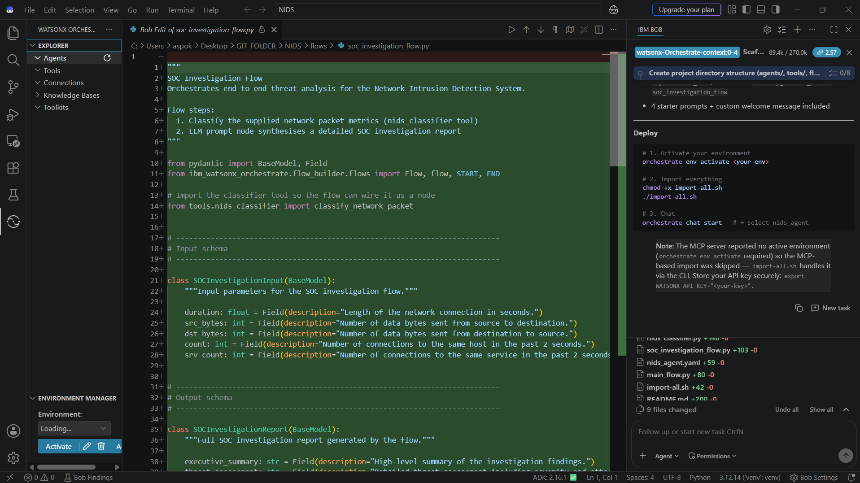
Required Files created using IBM bob -

Slide 7
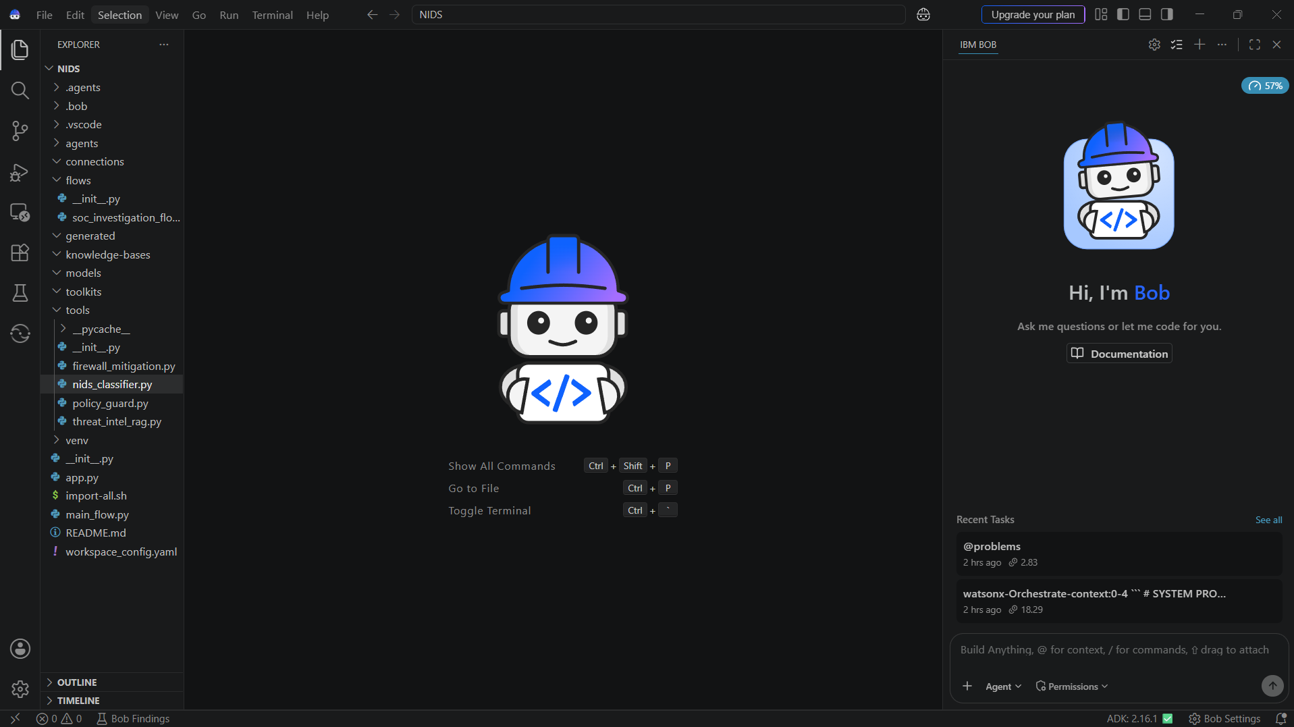
IBM Bob Screenshots:

Slide 8
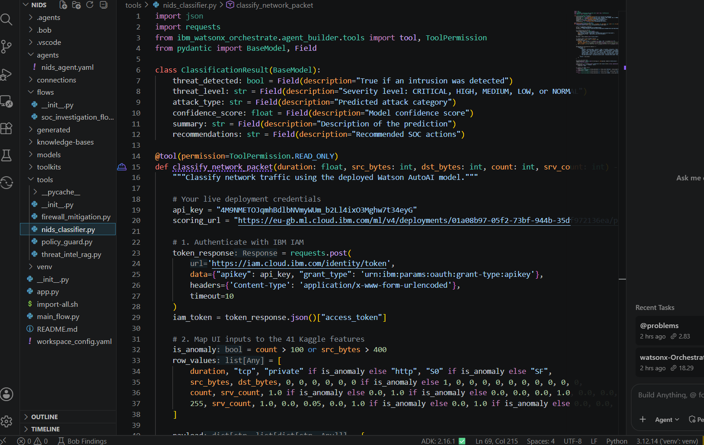

Slide 9
Architecture blueprint for IBM bob:

Slide 10

Role of Agentic AI in the solution
Role of Agentic AI in NIDS AGENT
Autonomous Alert Triaging: Eliminates manual alert parsing by giving the model agency to autonomously call classification tools, cross-examine packet headers, and correlate anomalous signals.
Multi-Step ReAct Iterations: Instead of static single-turn responses, the agent initiates iterative "Thought-Action-Observation" loops: identifying attack categories, querying the vector database for CVE signatures, and formulating defence actions
Tool Execution Autonomy: The agent converts natural-language threat descriptions into machine-executable firewall rules (iptables, AWS Security Group updates) and validates syntax before deployment
Dynamic Policy Enforcement: Leverages IBM Granite Guardian to evaluate remediation commands, ensuring the agent never isolates critical DNS, DHCP, or internal enterprise subnets.

Slide 11
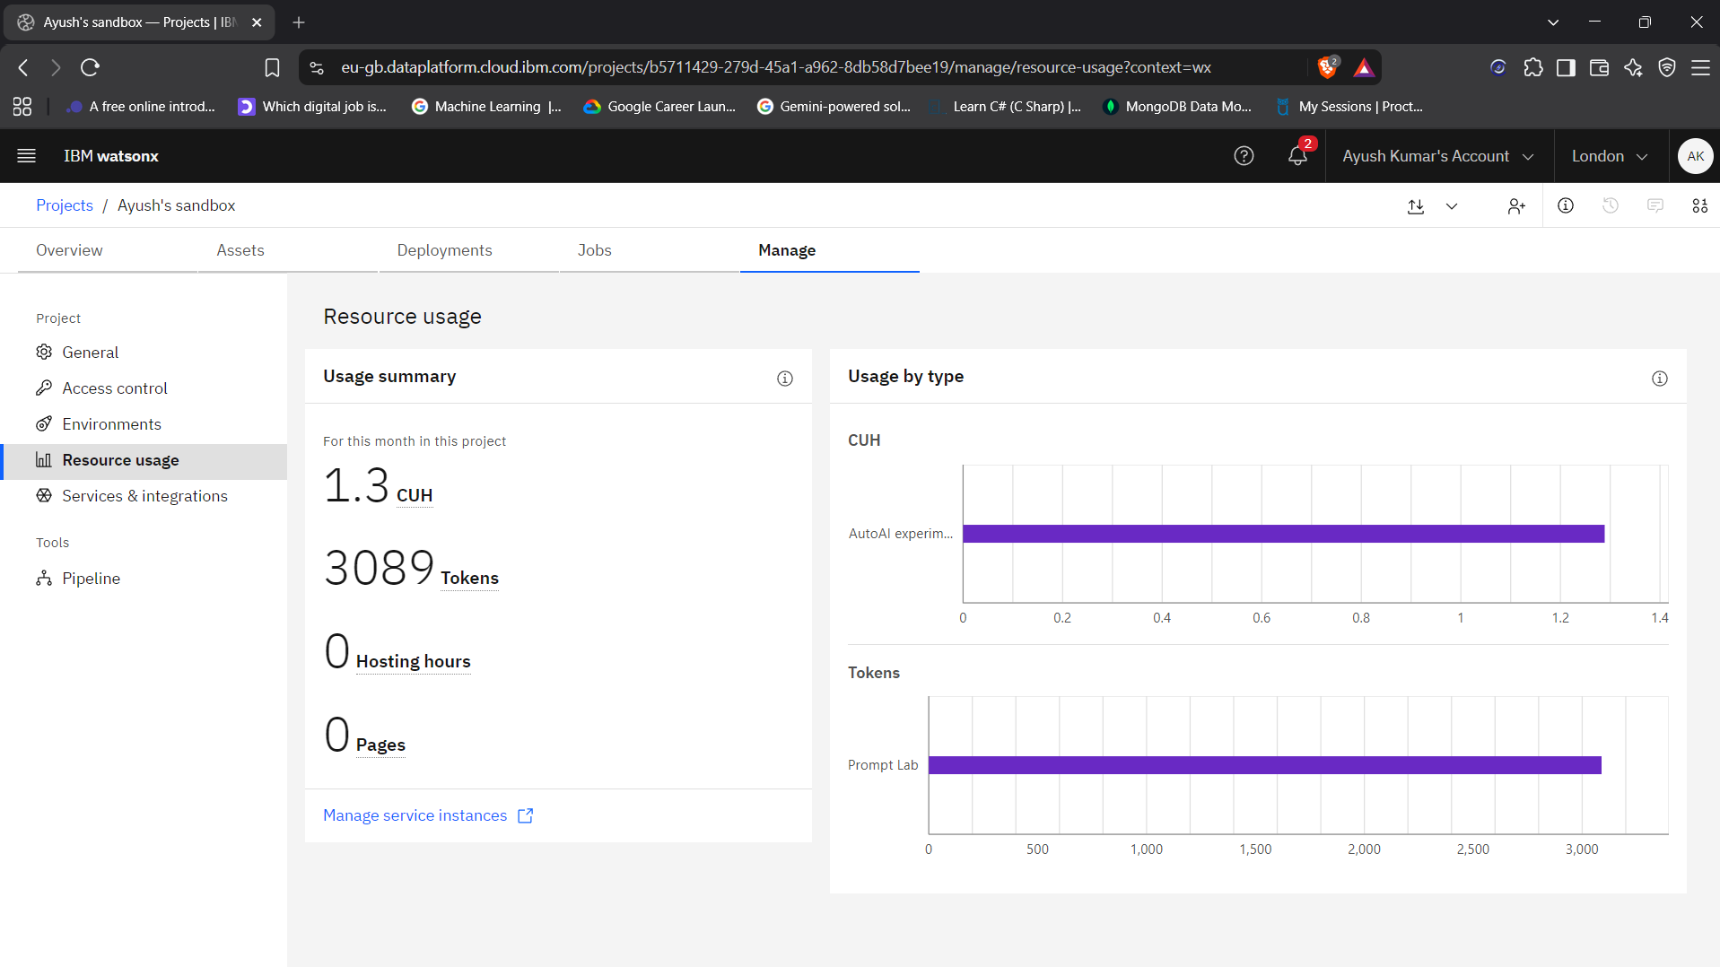
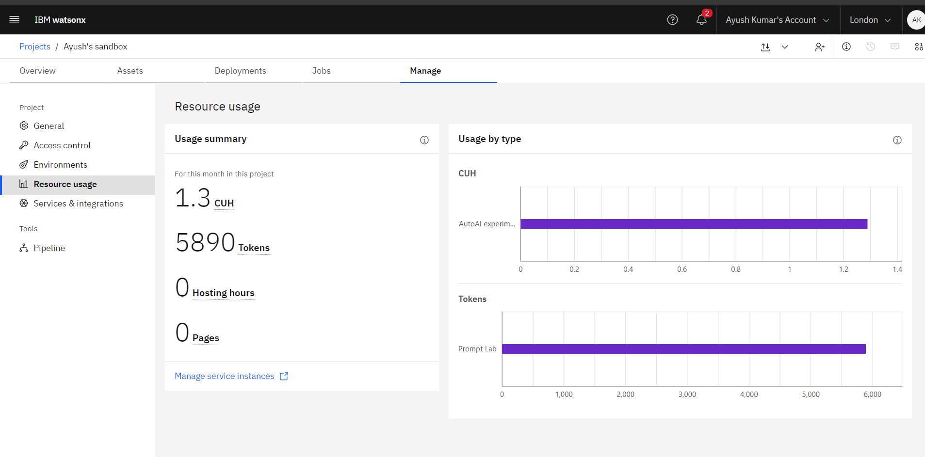
Token Usage
2801 token are used
Before Prompt
After the Prompt
·
·
·

Slide 12
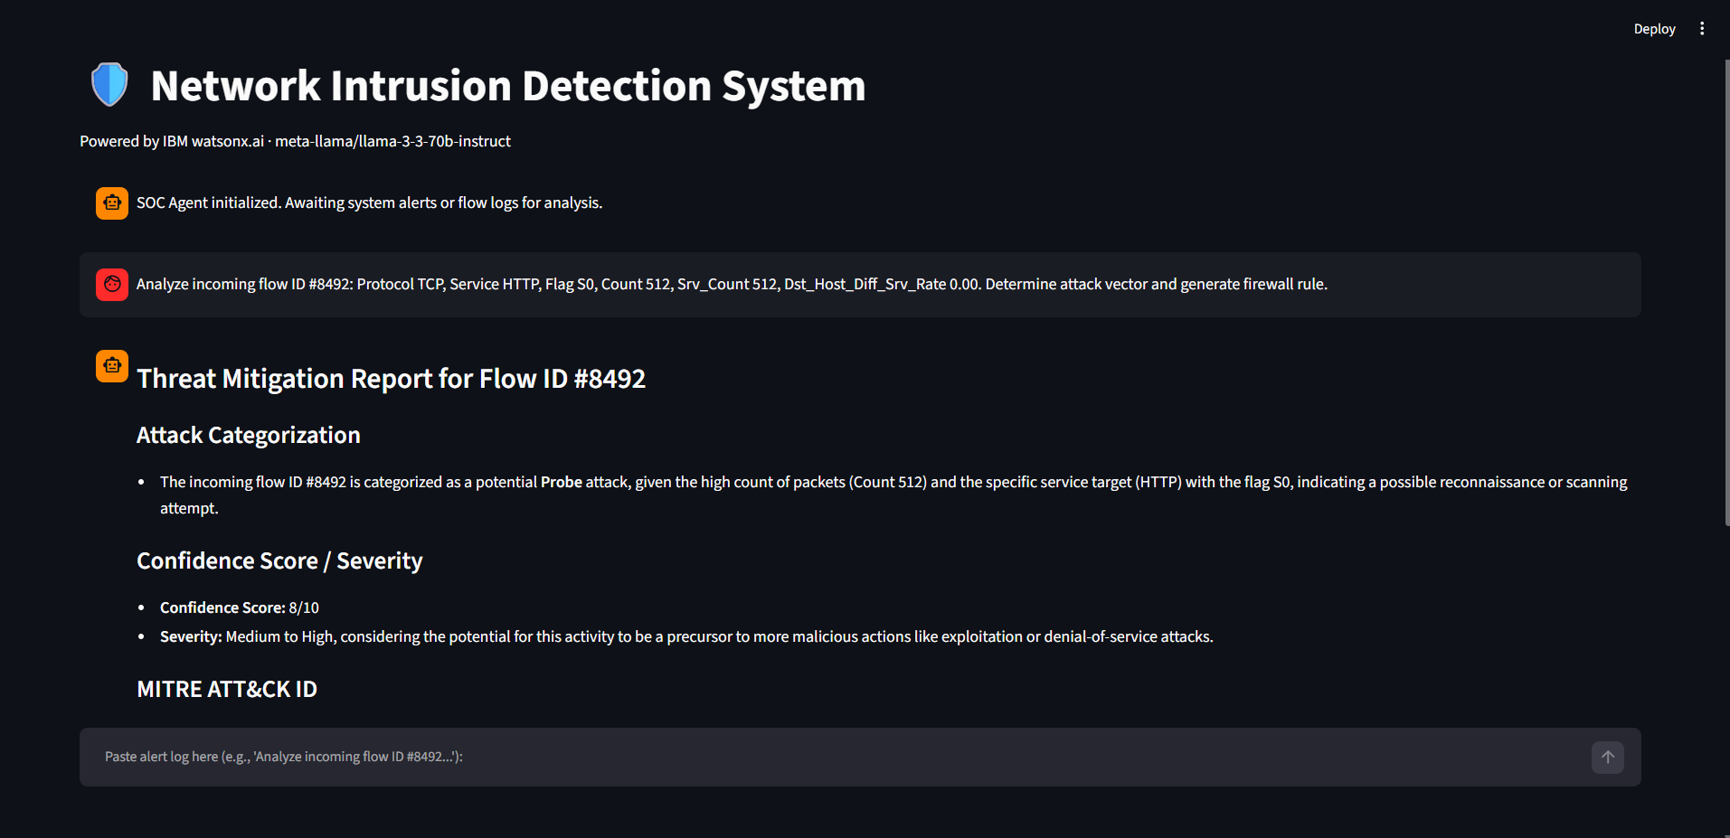
Project Output Screenshot
Please put IBM Bob output screenshots with 2-3 prompts.
You can take 2-3 more slides for each screenshot
·
·
·

Slide 13
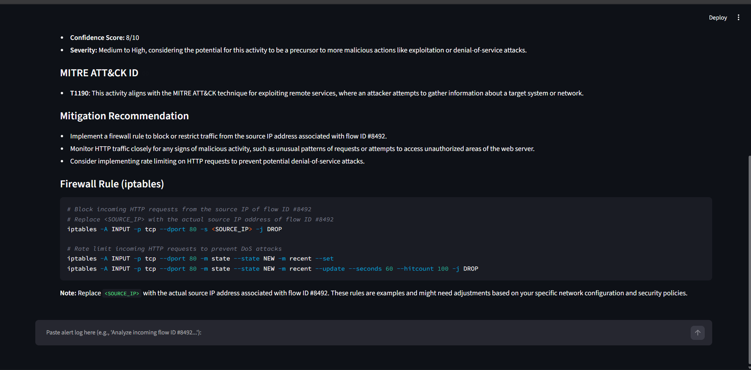
Project Output Screenshot
Please put IBM Bob output screenshots with 2-3 prompts.
You can take 2-3 more slides for each screenshot
·
·
·

Slide 14
Novelty and Uniqueness
Hybrid ML + Agentic Workflow: Merges high-speed tabular ML inference with deep contextual LLM reasoning .
Zero-Lag Autonomous Defence: Reduces Mean Time to Respond (MTTR) from hours to sub-second automated firewall policy generation.
Grounded Compliance via RAG: Eliminates hallucinated security advice by binding LLM outputs strictly to standardized MITRE ATT&CK frameworks and CVE repositories.
Real-Time Feedback Loop – Continuously adapts recommendations based on daily food logs and user behavioor.
Enterprise-Grade Guardrails: Directly incorporates Granite Guardian to preserve uptime and prevent self-inflicted network denial-of-service.
Actionable Output: Doesn't just detect threats; it writes the exact iptables code required to stop them.

Slide 15
Git Hub Link
https://github.com/const-ayush57/NIDS-SOC-Agent-
·
·
·

Slide 16
Future Scope
1. Direct SIEM/SOAR Ingestion -
Direct API connectors to enterprise security tools like IBM QRadar, Splunk, and Microsoft Sentinel for real-time live packet streaming
2. Decoupled Edge Deployment -
Porting lightweight quantized Granite models to local edge gateways and offline intranet nodes using localized SQLite rule stores for air-gapped environments
3. Automated PCAP Forensics -
Expanding agent capabilities to ingest raw .pcap binary captures, reconstruct TCP streams, and perform automated binary payload inspection.
4.Database Integration: Connect to a time-series database or MongoDB to store historical threat classifications and visualize long-term network attack trends on a comprehensive React/Node.js web dashboard.
5.Automated Execution: Wrap the validated firewall scripts in subprocess modules to automatically execute the blocking rules on the host OS or border gateway without human intervention.
·
·
·

Slide 17
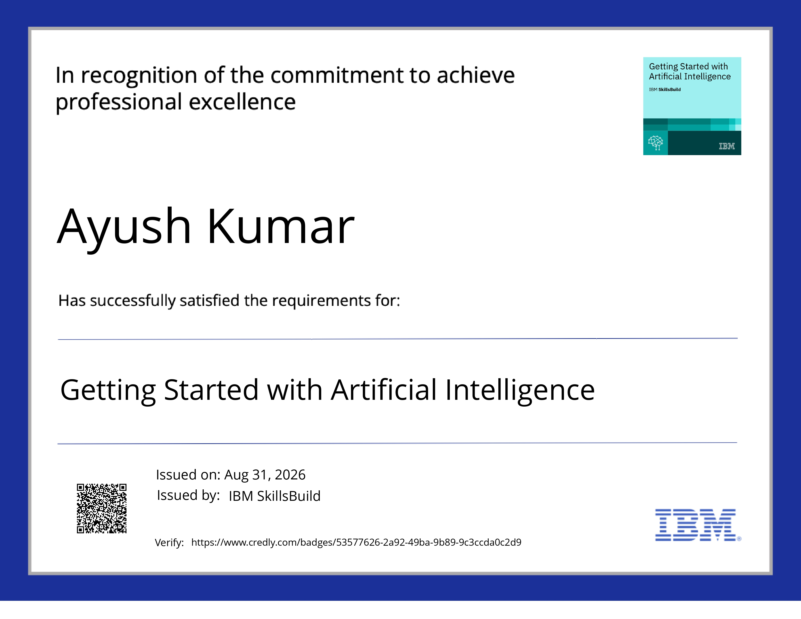
Certificates Earned:
Please add your credly certificate(Getting Started with Artificial Intelligence)

Slide 18
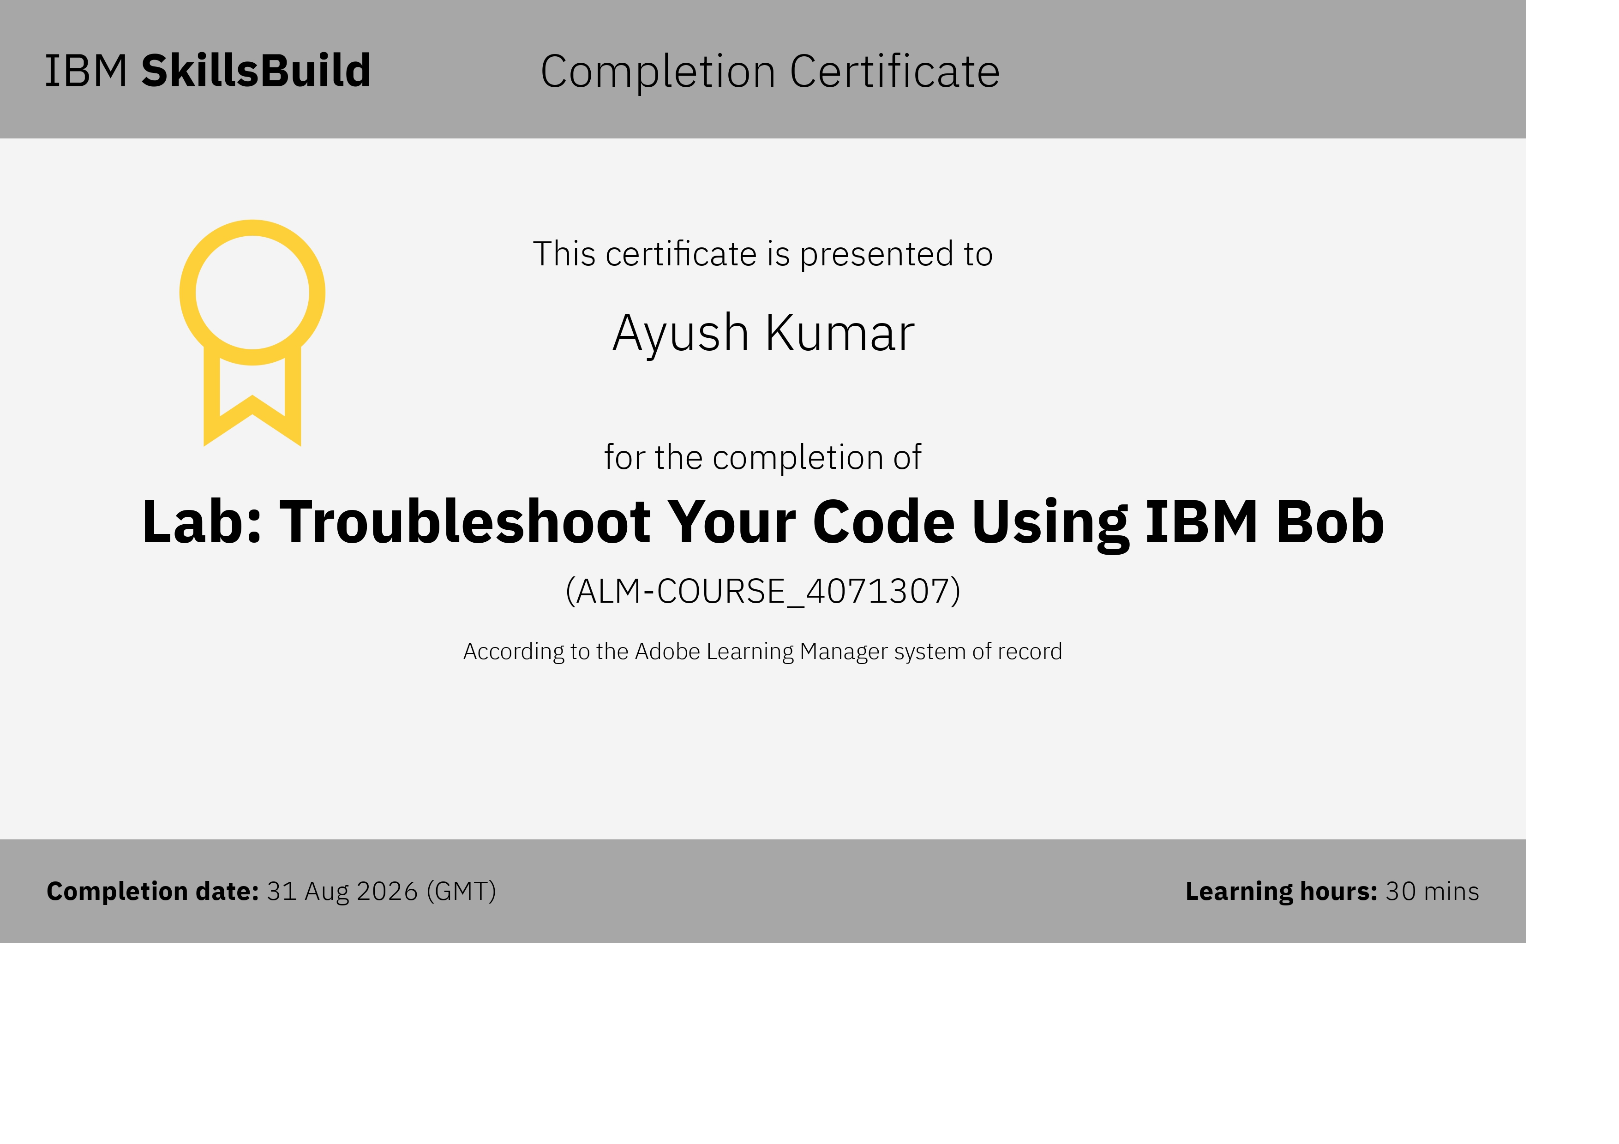
Certificates Earned:​
Add your IBM BOB Certificate

Slide 19


